Slide 1

PHISHING AWARENESS TRAINING
Internship at CodeAlpha
PRESENTED BY:
SADARI KARTHIK KUMAR YADAV
STUDENT ID: CA/CS3/11125
BATCH: APRIL BATCH - M3
DOMAIN : CYBER SECURITY

Slide 2
CONTENTS
Introduction
What is Phishing
Types of Phishing Attacks
Signs of a Phishing Attempt
Why it’s important for you to follow phishing guidance actively
Preventing and Responding to Phishing Attacks
Example of Phishing Mail
Original Mail
Phishing Simulation Exercises
Conclusion

Slide 3
Introduction
Welcome to Phishing Awareness Training.
Phishing attacks are among the most common cyber threats today.
This training module aims to educate you about recognizing and avoiding phishing emails, websites, and social engineering tactics.

Slide 4
What is Phishing?
Phishing is a form of cybercrime that uses social engineering techniques to trick individuals into revealing sensitive information, such as usernames, passwords, credit card numbers, or other types of credentials.
In the context of phishing, social engineering refers to the psychological manipulation that takes place.
Rather than using technical hacking techniques, cybercriminals exploit human behavior to deceive the target.

Slide 5
Types of Phishing Attacks
Email Phishing: Deceptive emails that mimic legitimate sources, often containing links or attachments that lead to malicious websites or downloads.
Spear Phishing: Targeted attacks aimed at specific individuals or organizations, using personalized information to increase credibility.
Vishing: Phishing via voice calls, where scammers impersonate trusted entities to obtain sensitive information over the phone.

Slide 6
Types of Phishing Attacks contd…
Whaling: This is a type of phishing attack that specifically targets senior executives and high-profile targets. The content of a whaling phishing attempt often revolves around executive issues like company-wide decisions or sensitive financial matters.
Smishing: Phishing via SMS or text messages, tricking recipients into clicking malicious links or disclosing information.

Slide 7
Signs of a Phishing Attempt
Urgency: Phishing emails often create a sense of urgency to prompt immediate action.
Suspicious Links: Check links by hovering over them to reveal the actual URL, which may differ from what is displayed.
Generic Greetings: Phishing emails may use generic greetings like "Dear Customer" instead of addressing you by name.
Spelling and Grammar Errors: Legitimate organizations typically have professional communication, while phishing emails often contain errors.
Requests for Personal Information: Be cautious of emails requesting sensitive data like passwords, Social Security numbers, or financial details.

Slide 8
Why it’s important for you to follow phishing guidance actively
Personal Information Security: Phishing scams are designed to steal sensitive data such as credit card details, social security numbers, and login credentials. Active vigilance can prevent unauthorized access to your personal information, protecting you from identity theft.
Financial Protection: Phishing attacks often lead to financial fraud. By understanding and applying phishing guidance, you can avoid fraudulent transactions, saving you from financial losses.
Maintaining Privacy: Falling for a phishing attack can lead to privacy breaches, exposing your personal communications, photos, and other private data.

Slide 9
Preventing and Responding to Phishing Attacks
Check the Email Address: Phishing emails often come from email addresses that resemble genuine company addresses but are slightly altered or misspelled.
Check for Spelling and Grammar: Many phishing emails have spelling or grammatical errors. While legitimate companies can occasionally make mistakes, multiple errors are a warning sign.
Avoid Clicking Links in Emails: If an email asks you to log in to an account, manually type the website’s address into your browser instead of clicking the link.
Verify a Site’s Security: Ensure the site is secure before entering any information. Look for “https://” in the URL – the “s” stands for secure.

Slide 10
Preventing and Responding to Phishing Attacks (contd…)
Install Anti-Phishing Toolbars: Some browsers offer free anti-phishing toolbars. These toolbars match where you are going with lists of known phishing sites and will alert you.
Use Firewalls: Use a desktop firewall and a network firewall. This combination provides a double layer of defense against phishing attacks.
Regularly Check Your Accounts: Regularly check your bank, credit, and debit card statements to ensure that all transactions are legitimate.
Use Two-Factor Authentication (2FA): Always enable 2FA when it’s available. It adds an extra layer of security by requiring additional verification.

Slide 11
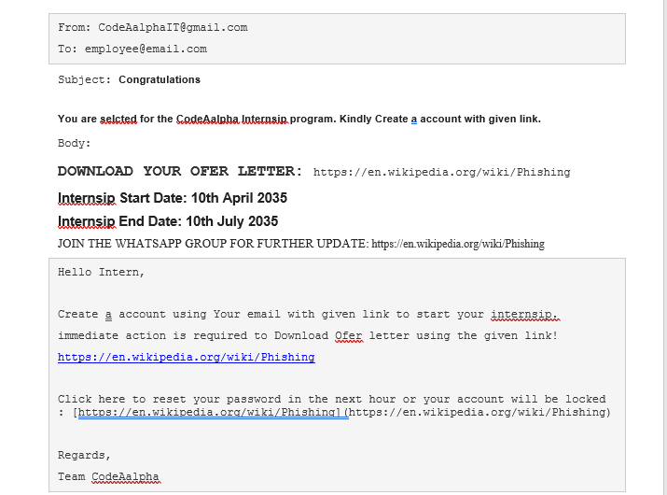
Example of Phishing Mail

Slide 12
Example of Phishing Mail: Errors in Mail
The sender's email address is suspicious: CodeAalphaIT@gmail.com. Double ‘a’ in Alpha.
Spelling errors: "selcted" instead of "selected," "Internsip" instead of "Internship," "account" instead of "an account," "ofer" instead of "offer."
Inconsistent formatting: The use of excessive capitalization in "YOUR OFER LETTER" and "CREATE A ACCOUNT" is unprofessional.
Suspicious links: The links provided lead to the Wikipedia page on phishing, indicating potential malicious intent.
Urgency: The email creates a sense of urgency by emphasizing "immediate action" required to download the offer letter and reset the password.

Slide 13
Example of Phishing Mail: Errors in Mail (contd..)
Lack of personalization: The email addresses the recipient as "Hello Intern" instead of using their name, indicating a generic or mass-sent message.
Grammar errors: "Create a account" should be "Create an account," and "Your email with given link" should be "Your email with the given link."
No official contact information: Legitimate internship programs usually provide official contact information for inquiries or assistance, which is lacking in this email.
Use of free email service: Legitimate companies typically use their domain-specific email addresses rather than Gmail or other free email services.

Slide 14
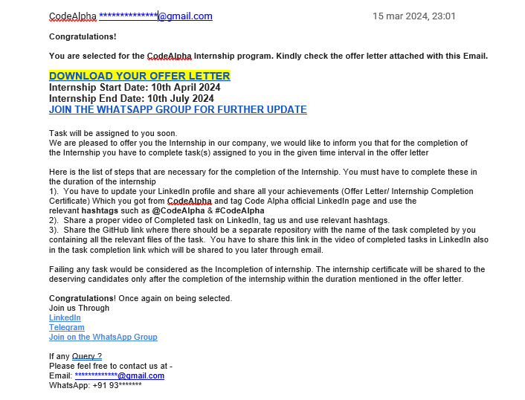
Original Mail

Slide 15
Phishing Simulation Exercises
Conduct simulated phishing exercises within your organization to test employees' awareness and response to phishing attacks.
Provide varying levels of difficulty and sophistication in simulated phishing emails to test employees' ability to discern between genuine and malicious messages.
Offer feedback and educational resources to employees who fall for simulated phishing emails, reinforcing learning and promoting a culture of cybersecurity awareness and improvement.

Slide 16
Reporting Phishing Attempts
Encourage employees to report phishing attempts promptly to the appropriate channels, such as IT support or security teams.
Implement clear reporting procedures and provide guidance on what information to include in reports.
Ensuring that employees know where and how to report suspicious emails promptly.
Implement a robust incident response plan to investigate reported phishing attempts swiftly, mitigate potential risks, and prevent further exploitation of organizational resources.

Slide 17
Conclusion
Phishing attacks continue to evolve, posing a significant threat to individuals and organizations.
By staying informed, exercising caution, and following best practices, we can collectively mitigate the risks associated with phishing.
Thank you for completing Phishing Awareness Training. Stay vigilant and help keep our digital environment secure

Slide 18
THANK YOU

